Slide 1
Hardware Design of a 1 GHz Amplifier and Initial Comparison with SimRF Application Note
K. Wang, R. Ludwig,
S. Bitar, S. Makarov
Aug 21 , 2011

Slide 2
Outline
Lumped matching network
Adding transmission line
Layout generation
Network analyzer measurement
SimRF simulation

Slide 3
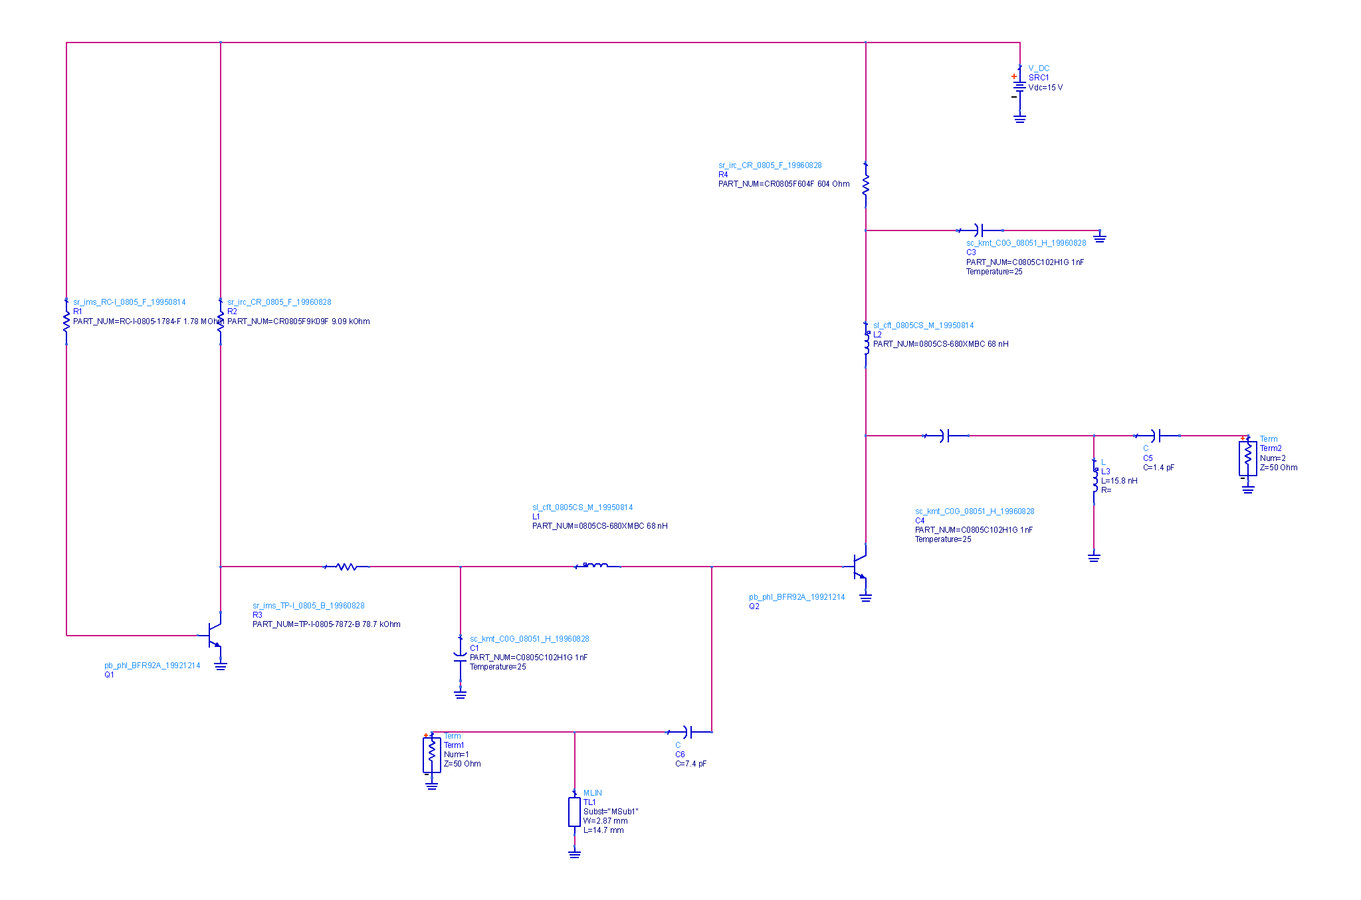
Lumped matching network
Design uses active bias network and adds components with artwork instead of ideal components.

Slide 4
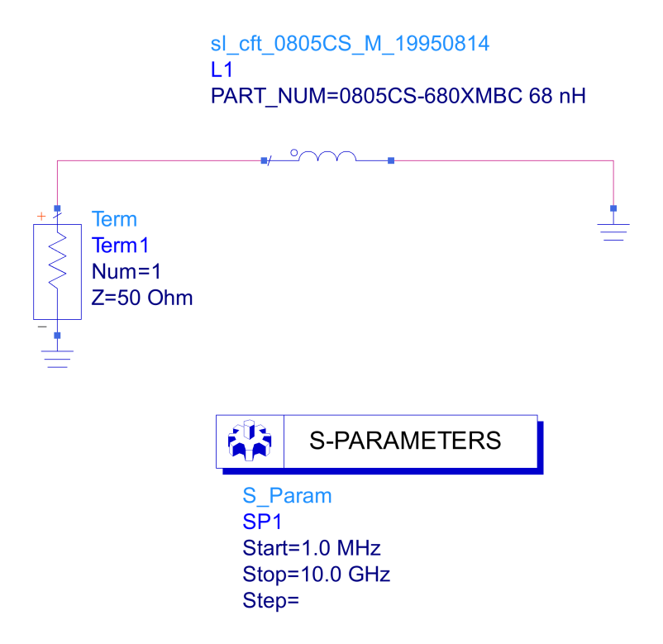
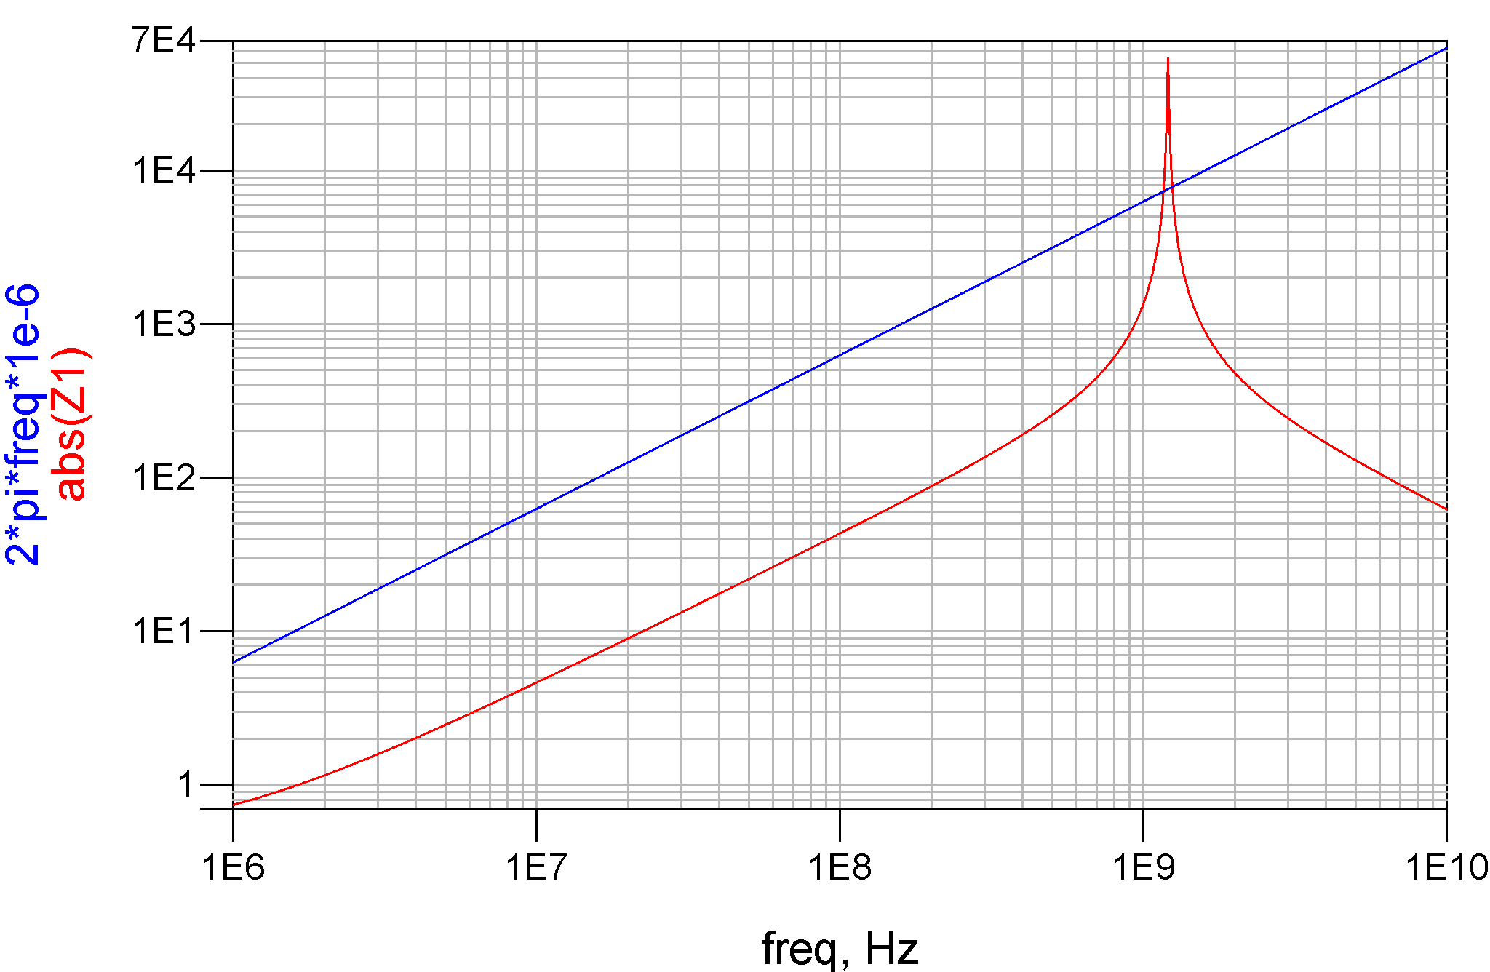
Lumped matching network
Modeling of SMT inductor as RF choke

Slide 5
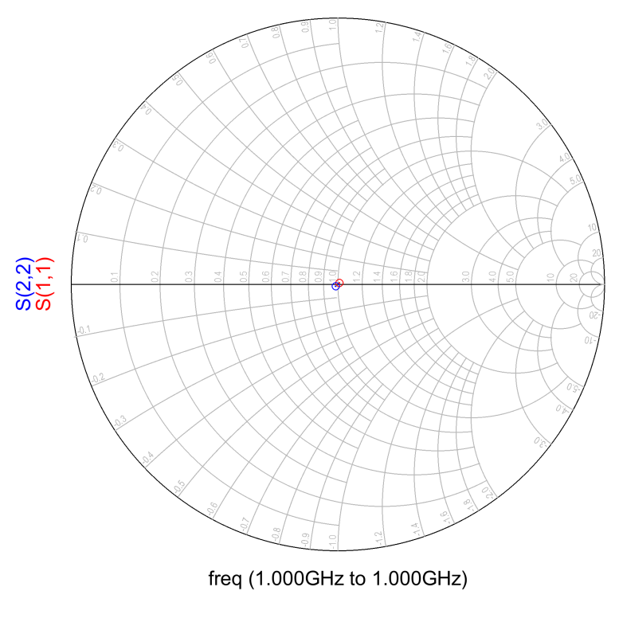
Lumped matching network
S-parameter extraction to test matching at input/output

Slide 6
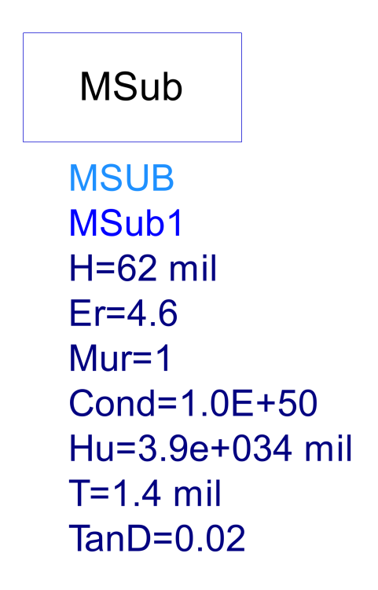
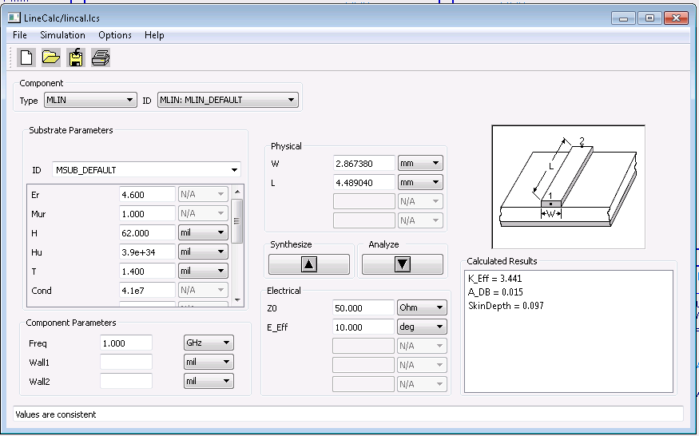
Adding transmission line
Specifying a 64 mil thick FR4 substrate and calculate TL parameters

Slide 7
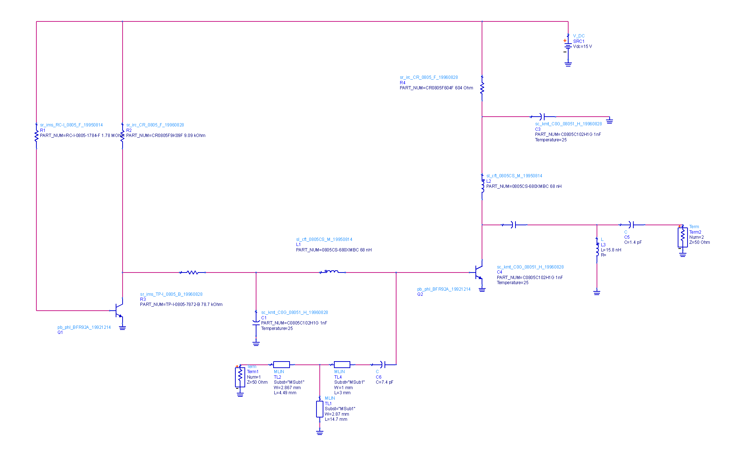
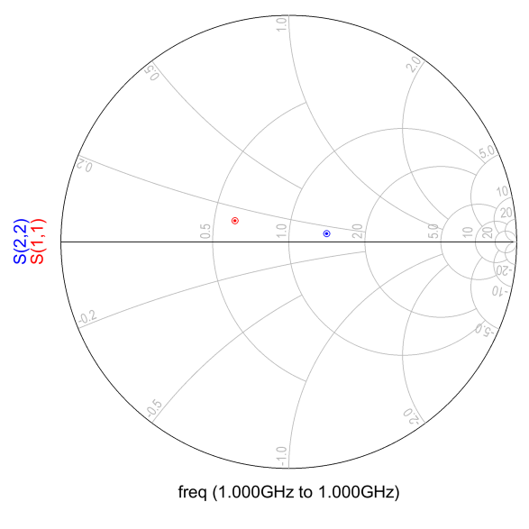
Adding transmission line
Adding transmission line to the input port
We note mismatches at input and output

Slide 8
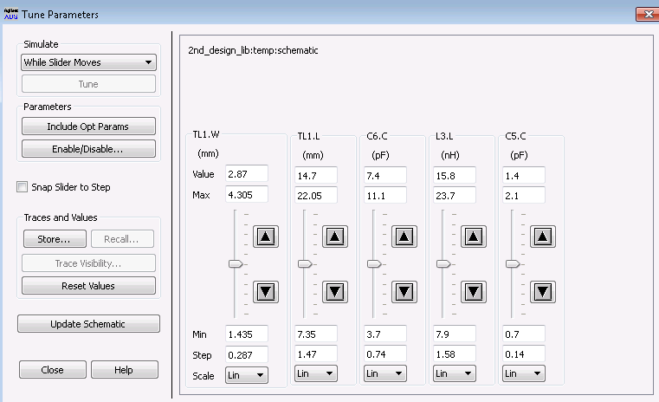
Adding transmission line
Using tuning tool to match input/output
Repeat the process until all the transmission line are added to the input and output port

Slide 9
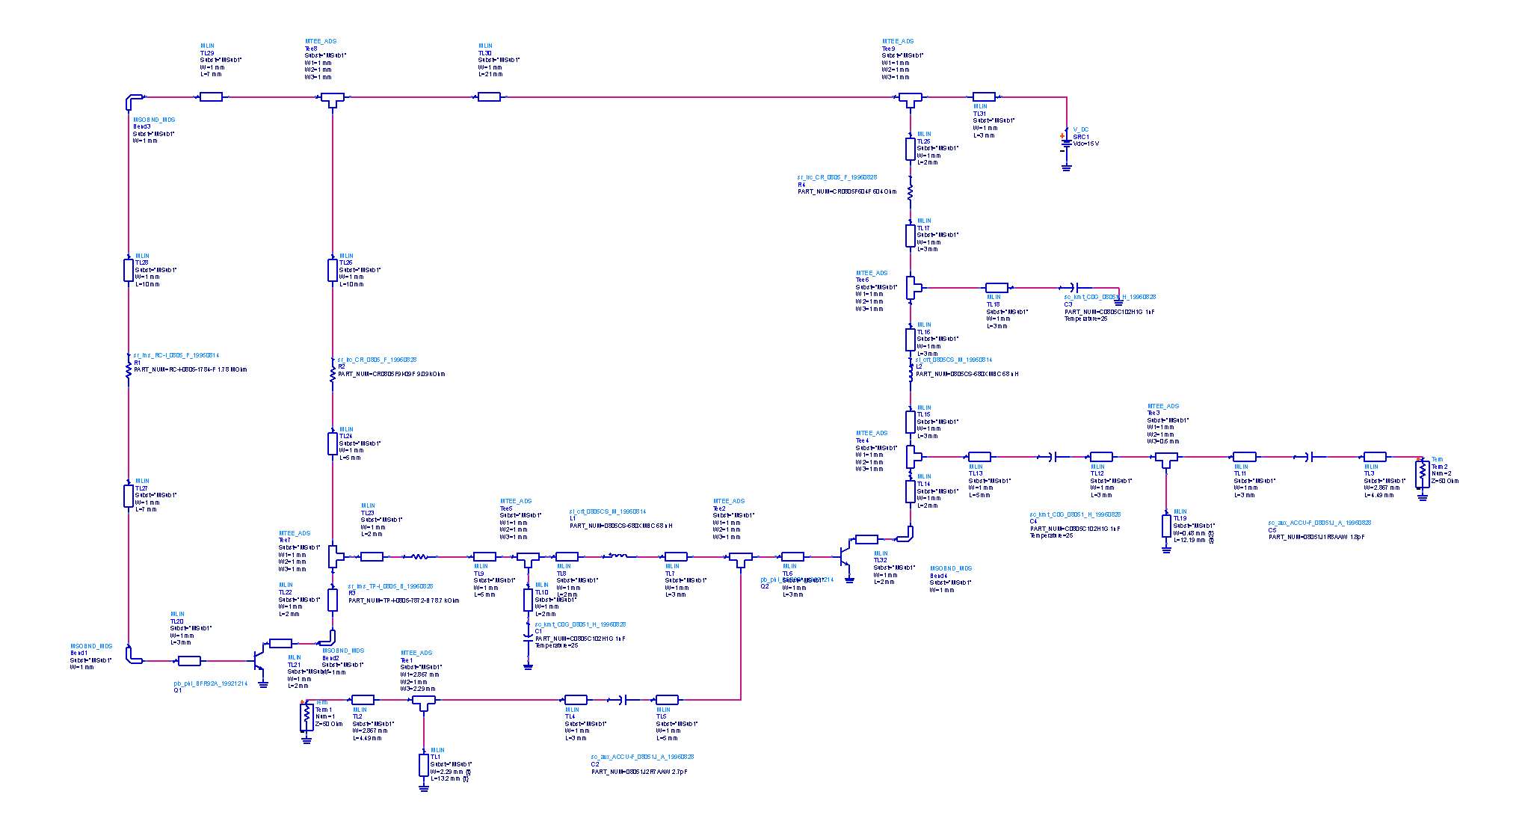
Adding transmission line
Final circuit schematic

Slide 10
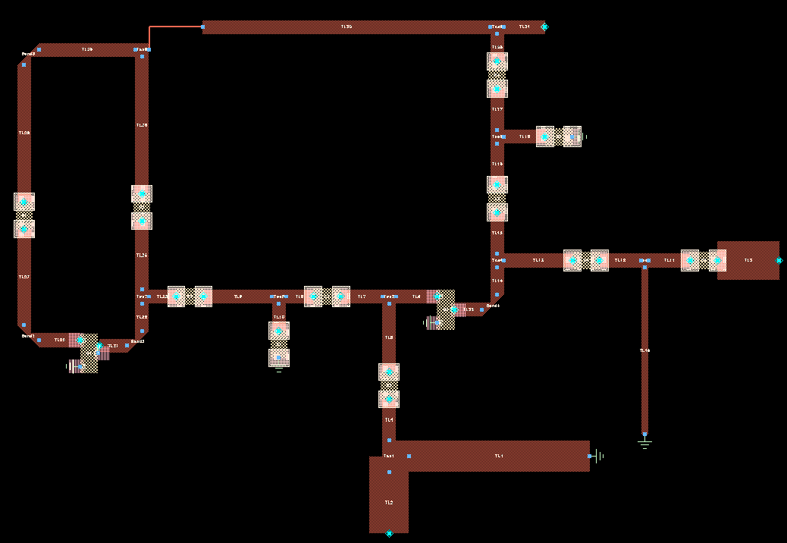
Layout generation
Use ADS Generate/Update layout to automatically generate layout

Slide 11
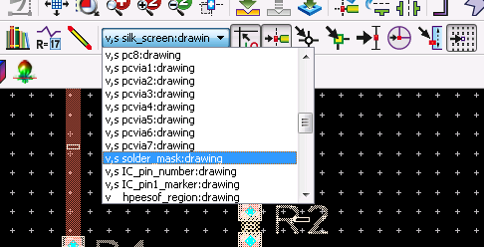
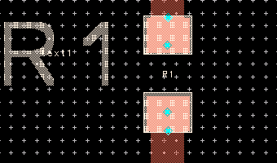
Layout generation
The size of resistors, capacitors and inductors are set to 0805 size.
Six layers are needed for the layout manufacture: 1) conductor, 2) ground plane, 3) top and 4) bottom solder masks, 5) via and 6) silkscreen.

Slide 12
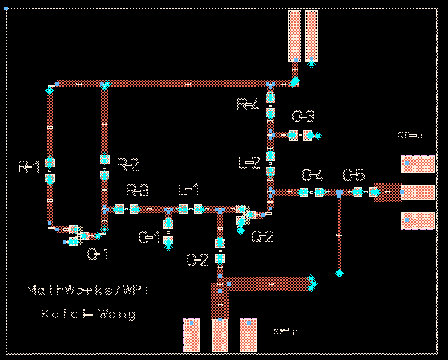
Layout generation
Final layout

Slide 13
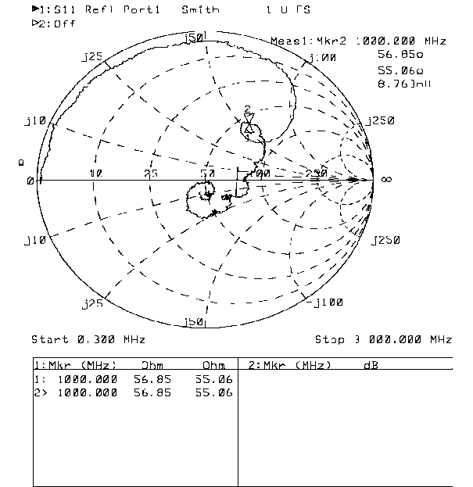
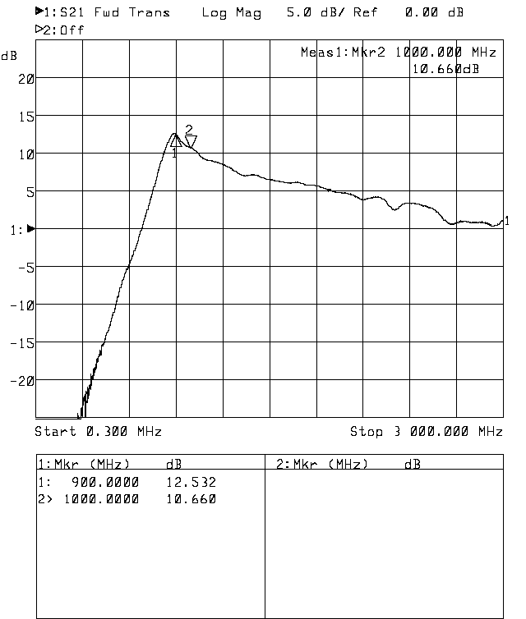
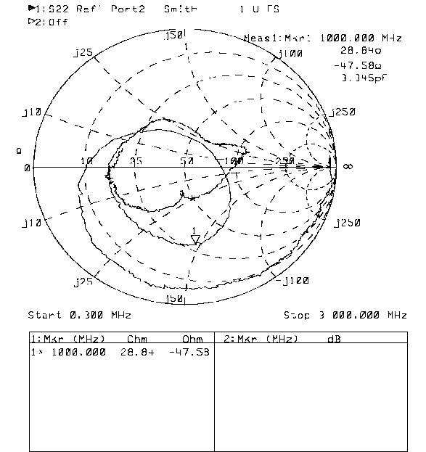
Network analyzer measurement
Forward gain versus frequency
S₁₁
S₂₂

Slide 14
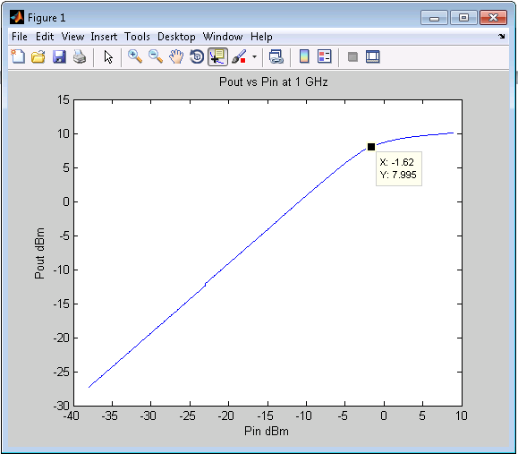
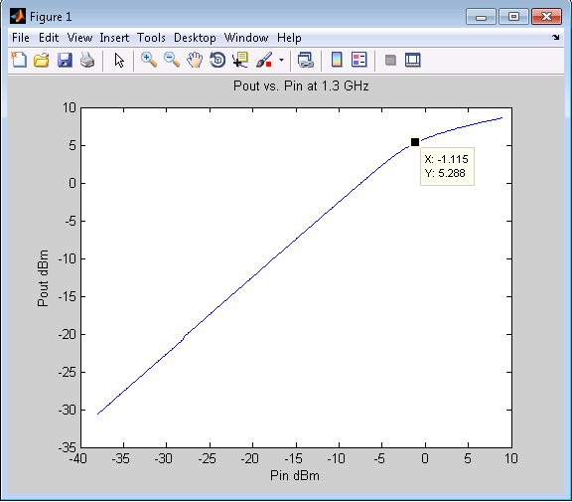
Network analyzer measurement
Gain compression at 1 GHz
Gain compression at 1.3 GHz

Slide 15
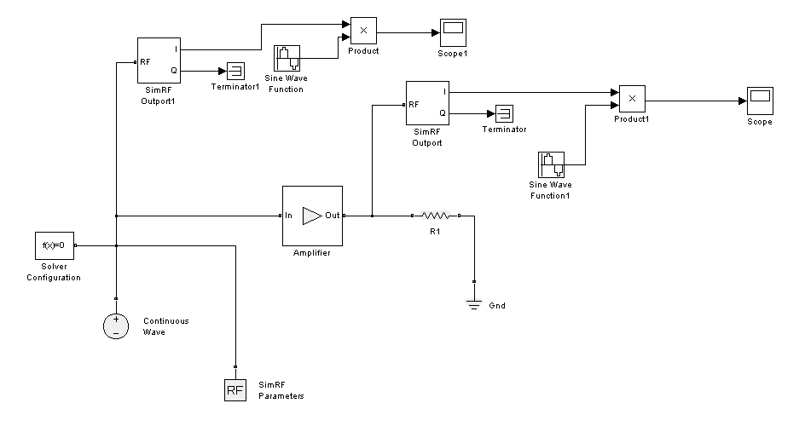
SimRF simulation

Slide 16
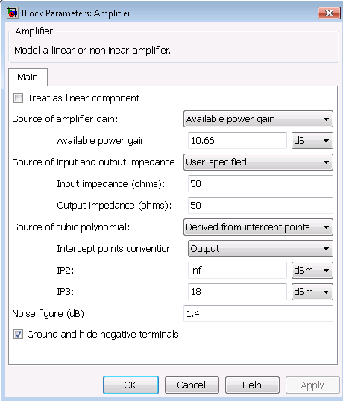
SimRF simulation
Based on NA measurements:
G = 10.66 dB (at 1GHz)
From
Thus

Slide 17
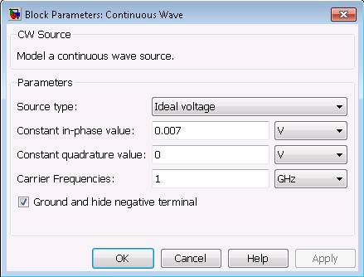
SimRF simulation
According to SimRF the power source equation is:
For an input power of -36dBm:

Slide 18
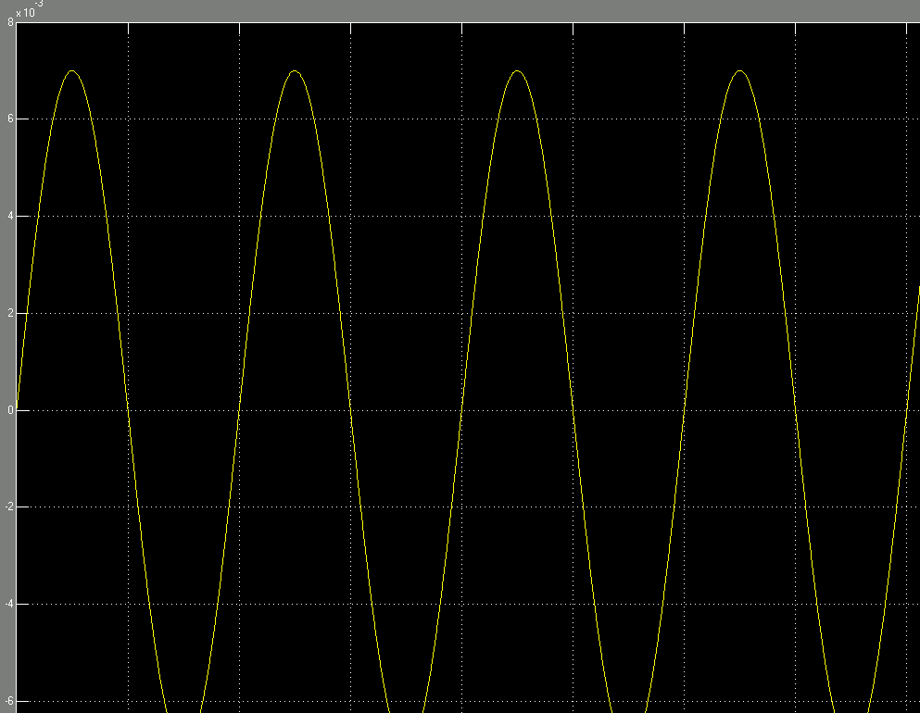
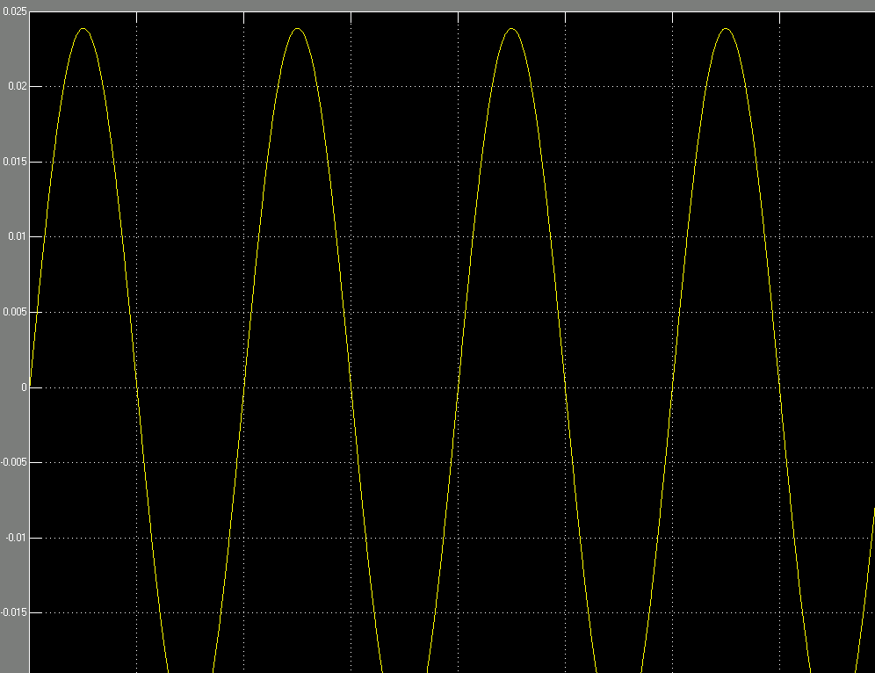

SimRF simulation – 1GHz
Input voltage 0.007 V

Slide 19
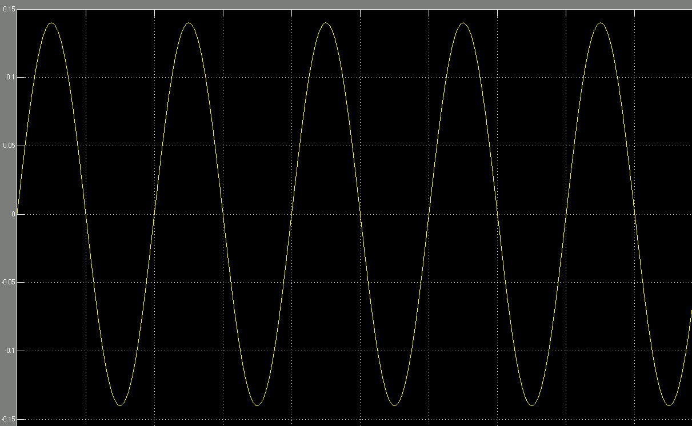
SimRF simulation – 1GHz
Input voltage 0.14 V
For an input power equal to -10 dBm, the input voltage is 0.14 V.

Slide 20
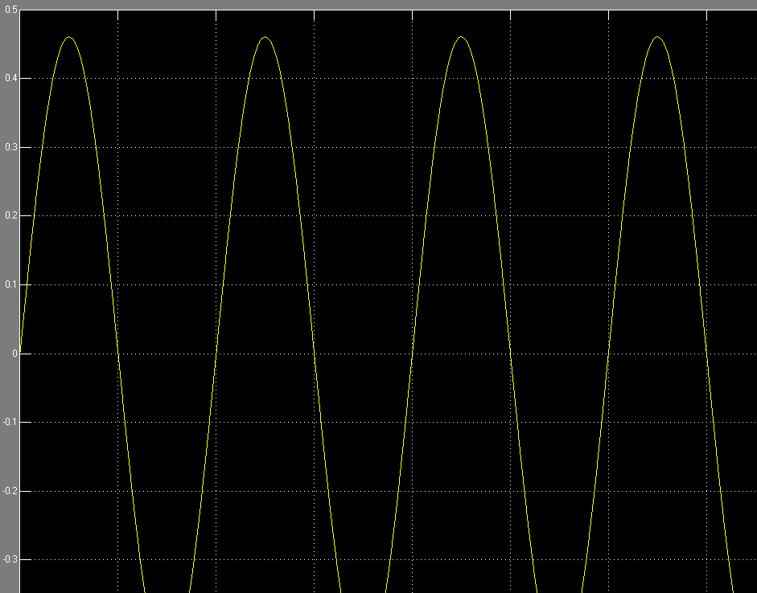
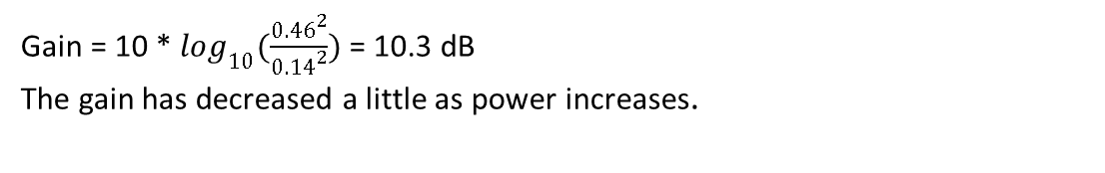
SimRF simulation – 1GHz
Output voltage 0.46 V
Gain = 10 * $\log_{10}(\frac{{0.46}^{2}}{{0.14}^{2}})$ = 10.3 dB
The gain has decreased a little as power increases.

Slide 21
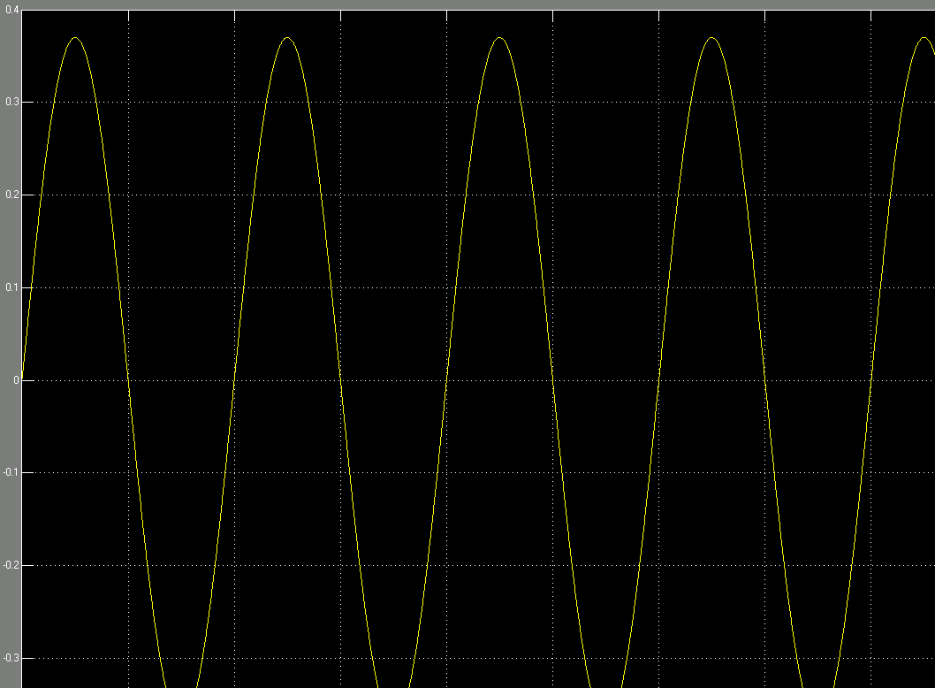
SimRF simulation – 1GHz
Input voltage 0.37 V
For the input power equal to -1.62 dBm which is the input power for 1 dB gain compression, the input voltage is set to be 0.37 V.

Slide 22
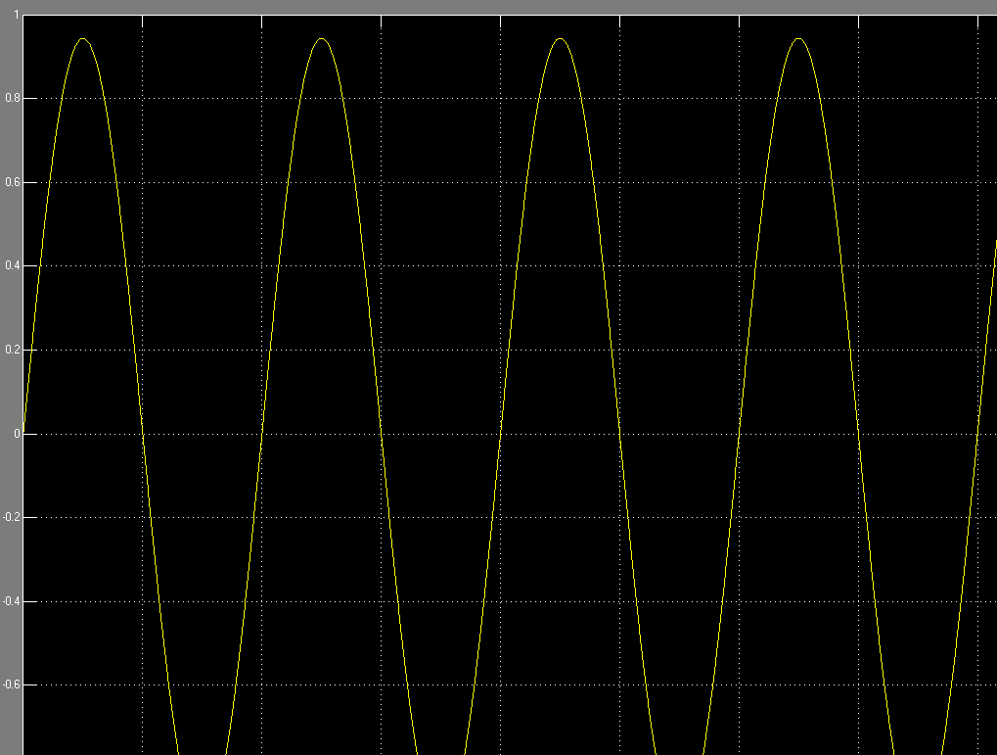
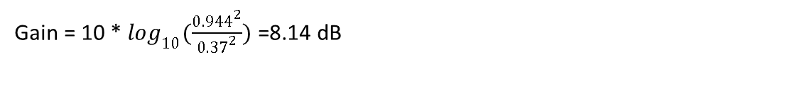
SimRF simulation
Output voltage = 0.944V
Output voltage 0.944 V
Gain = 10 * $\log_{10}(\frac{{0.944}^{2}}{{0.37}^{2}})$ =8.14 dB

Slide 23
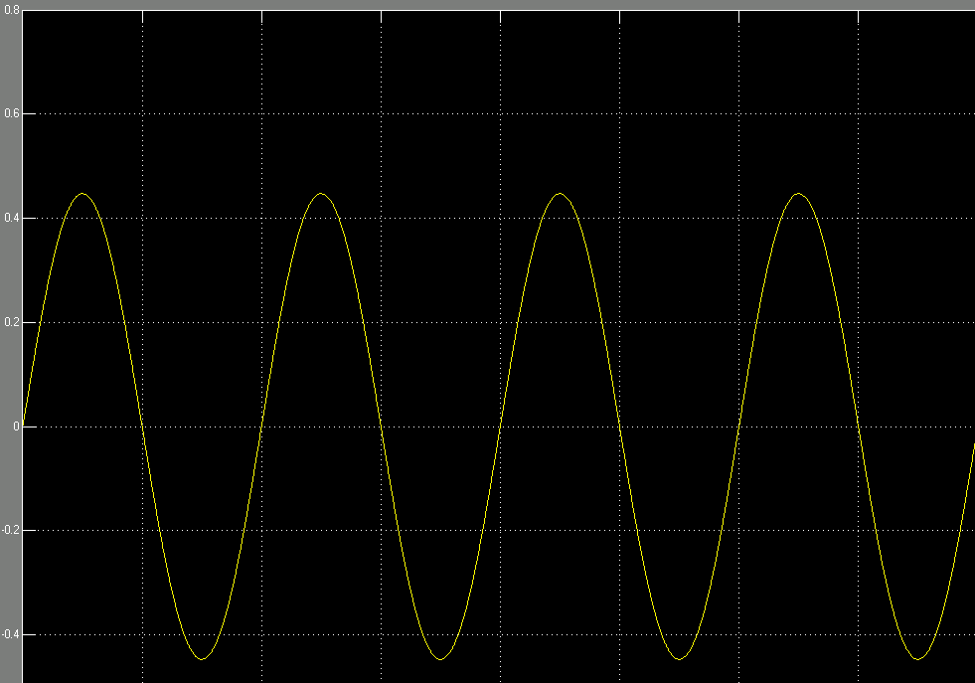
SimRF simulation – 1GHz
Input voltage: 0.4472 V
As the input power increases to 0 dBm, the input voltage is 0.4472 V.

Slide 24
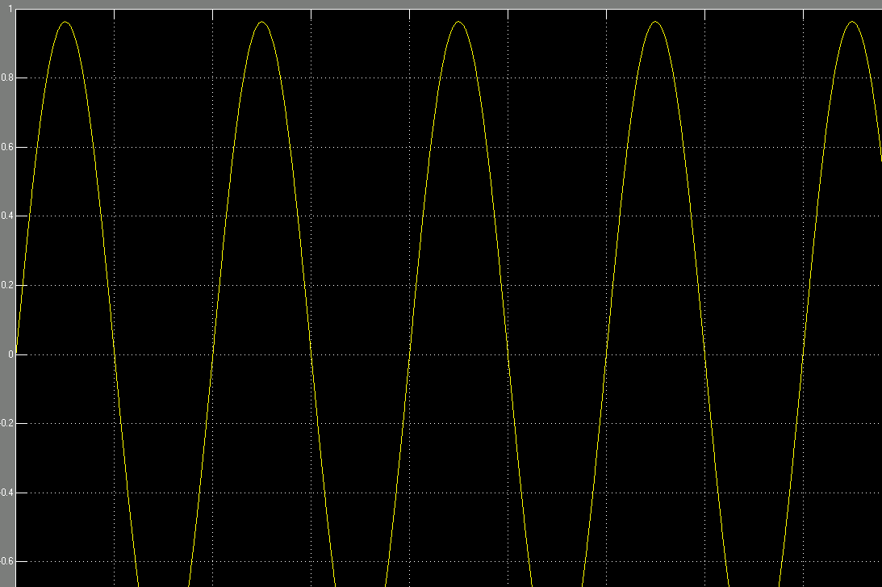
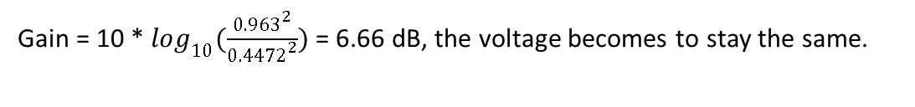
SimRF simulation – 1GHz
Output voltage: 0.963 V
Gain = 10 * $\log_{10}(\frac{{0.963}^{2}}{{0.4472}^{2}})$ = 6.66 dB, the voltage becomes to stay the same.

Slide 25
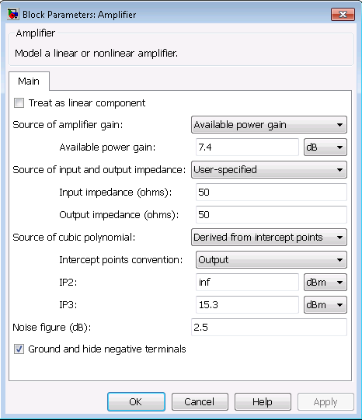
SimRF simulation – 1.3GHz

Slide 26
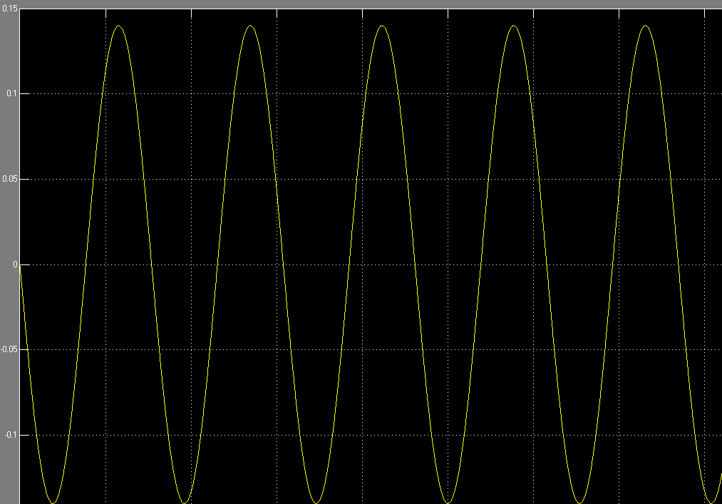
SimRF simulation – 1.3GHz
Input voltage: 0.14 V
The input power is -10 dBm, and the voltage is 0.14V

Slide 27
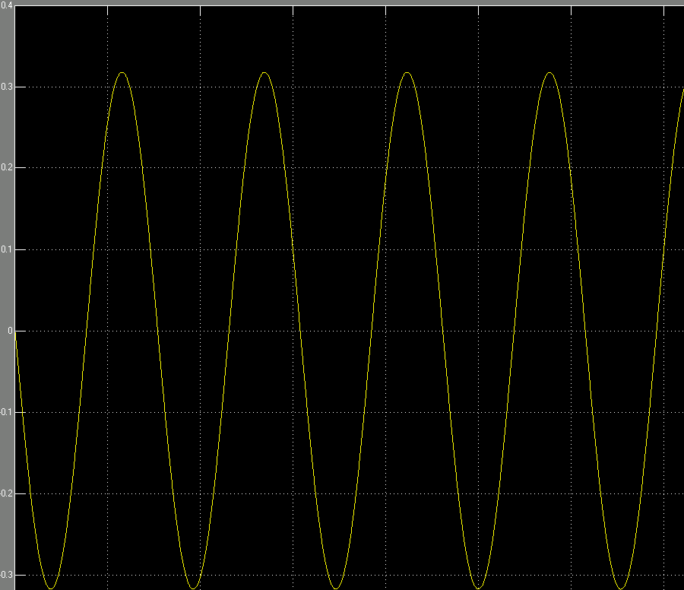

SimRF simulation – 1.3GHz
Output voltage 0.32 V
Gain = 10 * $\log_{10}(\frac{{0.32}^{2}}{{0.14}^{2}})$ = 7.18 dB

Slide 28
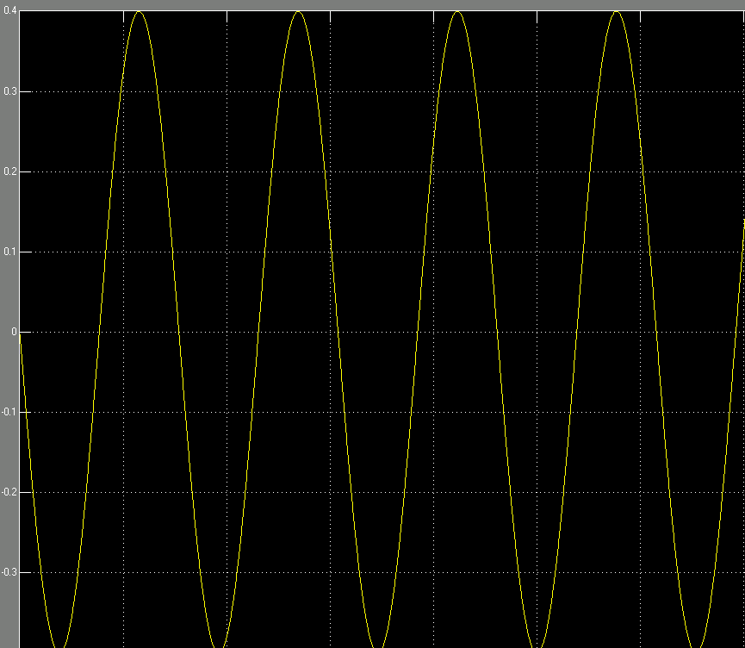
SimRF simulation – 1.3GHz
Input voltage 0.4 V
The input power is -1.1 dBm which is input power for 1 dB gain compression; the input voltage is 0.4 V.

Slide 29
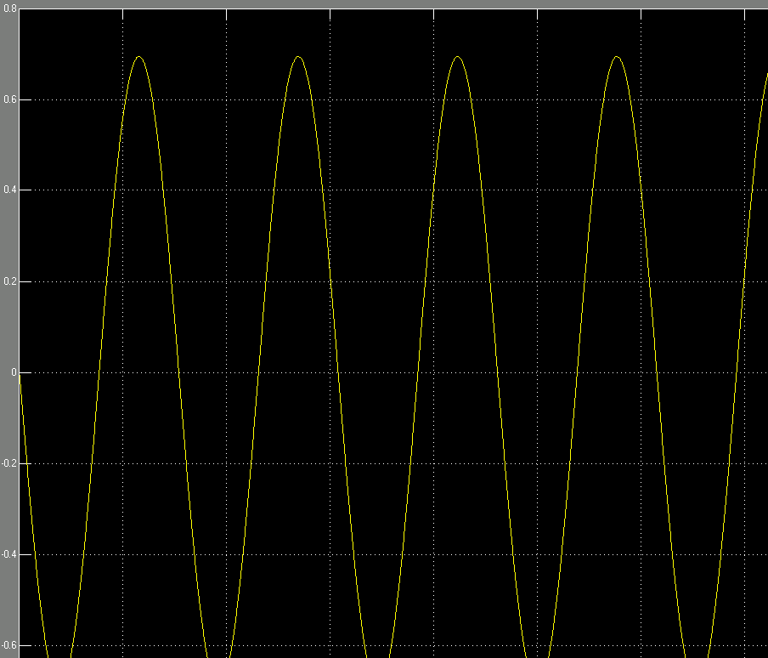
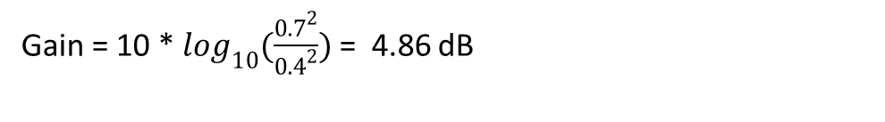
SimRF simulation – 1.3GHz
Output voltage 0.7 V
Gain = 10 * $\log_{10}(\frac{{0.7}^{2}}{{0.4}^{2}})$ = 4.86 dB

Slide 30
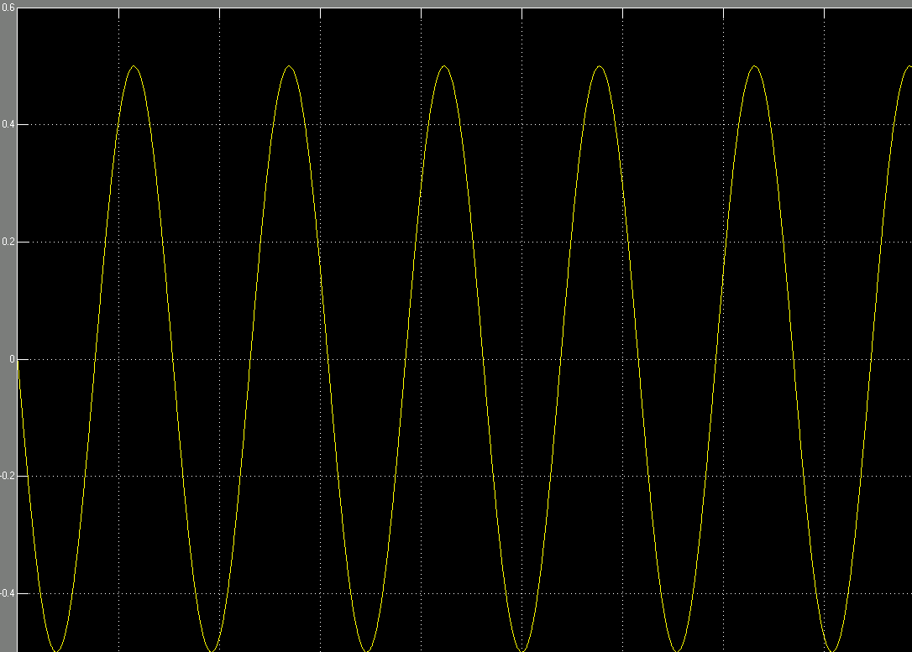
SimRF simulation – 1.3GHz
Input voltage 0.5 V
For input power of 1 dBm , the input voltage is 0.5 V.

Slide 31
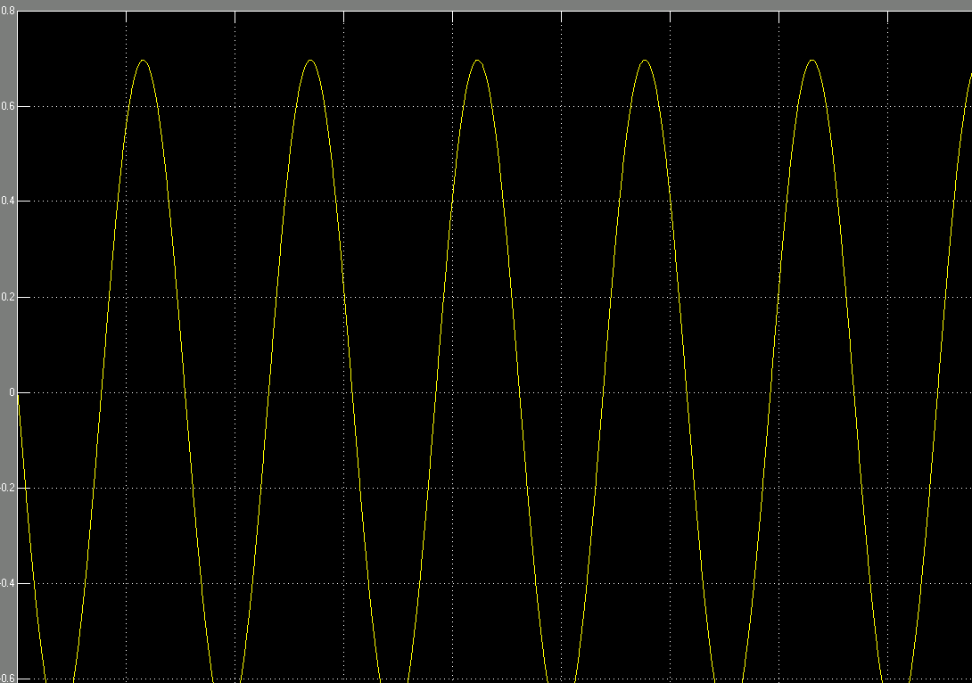
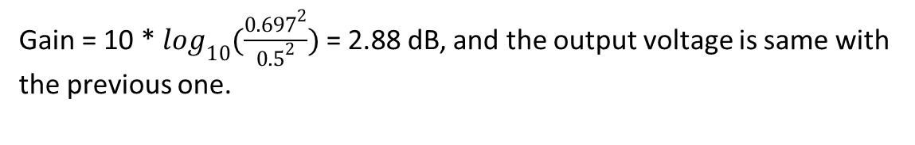
SimRF simulation – 1.3GHz
Output voltage 0.697 V
Gain = 10 * $\log_{10}(\frac{{0.697}^{2}}{{0.5}^{2}})$ = 2.88 dB, and the output voltage is same with the previous one.

