Slide 1
Noise Model of a High-Speed Operational Amplifier - Implementation in MATLAB® SimRF
Application Note
Sheila P. Werth, Stephen J. Bitar, & Sergey N. Makarov
ECE Dept. WPI, Worcester, MA
July 5th 2011

Slide 2
Outline
Concept of a noisy operational amplifier
Two basic op-amp circuits
Equivalent input noise
Extra contribution of noisy resistors R1, R2
Generic model of an op-amp circuit with noise – noise figure
Noise figure of an op-amp
MATLAB script for finding the noise figure
How is the noise model of an operational amplifier implemented in SimRF?
Test of op-amp model
Amplifier model example in SimRF

Slide 3
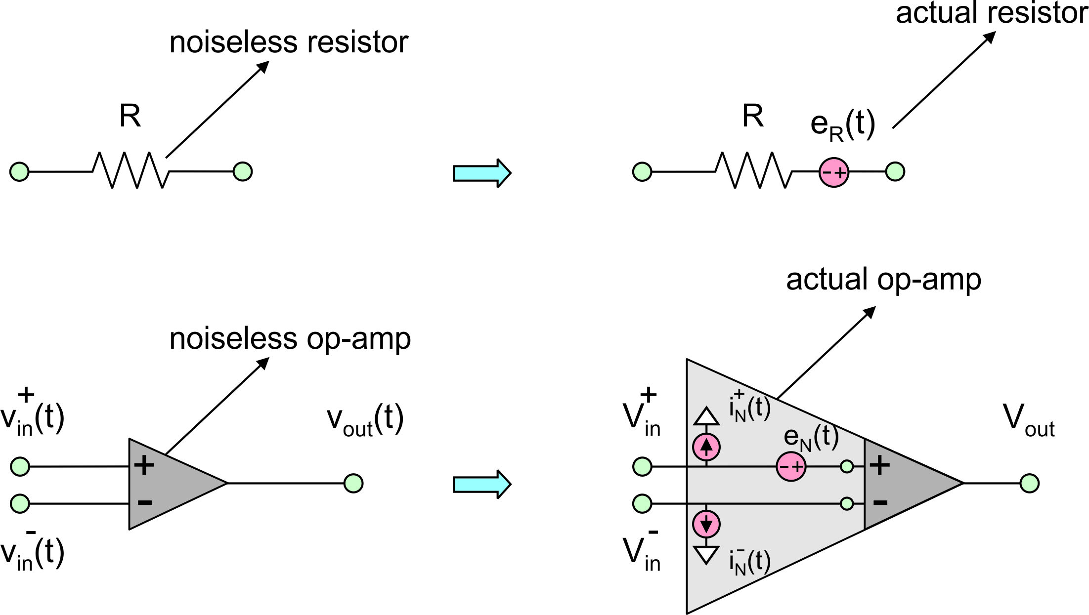
Concept of a noisy operational amplifier
Op-amp datasheet reports:
Resistor noise model:
Amplifier noise model:
B – circuit bandwidth in Hz (bandwidth over which white noise is collected)

Slide 4
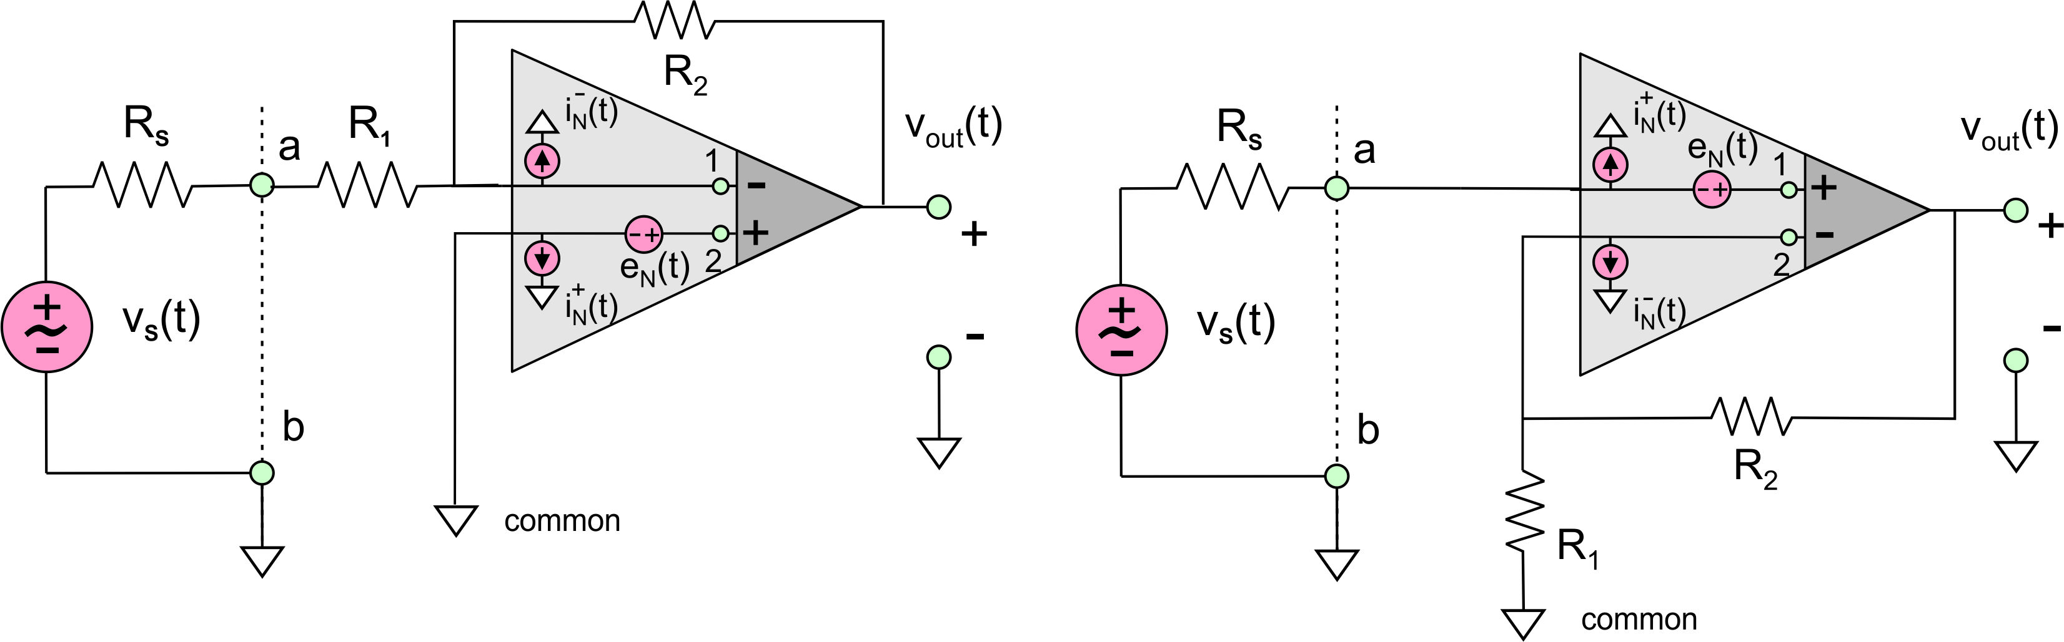
Two basic op-amp circuits (inv. and non-inv. configurations)
Inverting configuration :
Non- inverting configuration:

Slide 5
Equivalent input noise
Inverting configuration:
Non-inverting configuration:

Slide 6
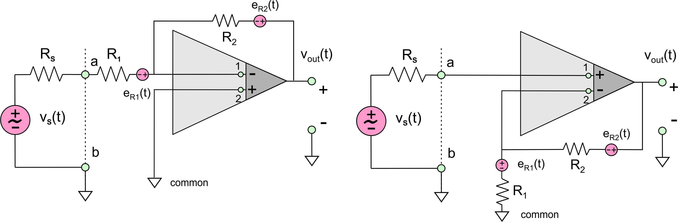
Extra contribution of noisy resistors R₁, R₂
Inverting configuration:
Non-inverting configuration:

Slide 7
Extra contribution of noisy resistors R₁, R₂ (cont.)

Slide 8
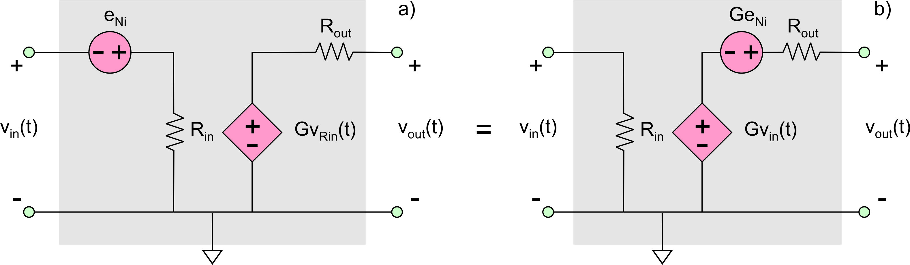
Generic model of an op-amp circuit with noise – noise figure
Noise factor:
Noise figure:
Added noise:
Input (reference) noise:
Inf. input res.:
Matched input res.:
(MATLAB SimRF)

Slide 9
Noise figure of an op-amp may be
surprisingly high…

Slide 10
… but it decreases with a higher source resistance (causing a higher input noise)
…or when a better IC chip is used
Question: Why use an op-amp then?
Answer: One major advantage is a high gain; another advantage is matching flexibility

Slide 11
MATLAB script for finding the noise figure using the previous analysis:

Slide 12


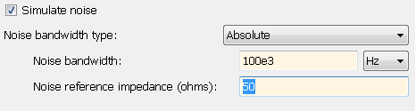
How is the noise model of an operational amplifier implemented in SimRF?
Run MATLAB script given above and calculate the op-amp noise figure in dB. If you do not know source impedance R_{S} exactly, use an estimated value.
Insert the noise figure value into
the amplifier block
3. Explore block “SimRF parameters”
4. Set noise reference impedance to be exactly equal to the value of your source impedance R_{S} identified previously.
5. Set noise bandwidth greater than
or equal to the expected system
bandwidth

Slide 13
Test of op-amp model
Construct the op-amp model in SimRF as described above
Short out its input
Measure rms added noise at the output
Compare this value with the corresponding theoretical prediction

Slide 14





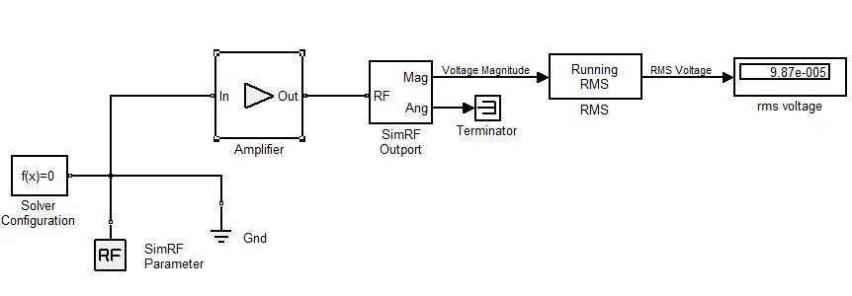
SimRF set up
Parameters: You already calculated a noise figure of 30dB for this particular amplifier with a voltage gain of 50. Now, enter these parameters:
You calculated the noise figure based upon a 50 ohm reference impedance and B= 20 kHz so:

Slide 15

Theory vs. simulations
The calculated rms output noise voltage is:
The output from the experimental setup is a close match:
The experimental setup calculates a running rms over a finite time window - this could be a source of error:

Slide 16
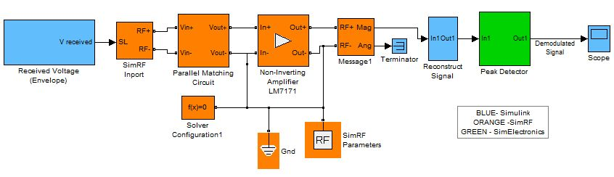
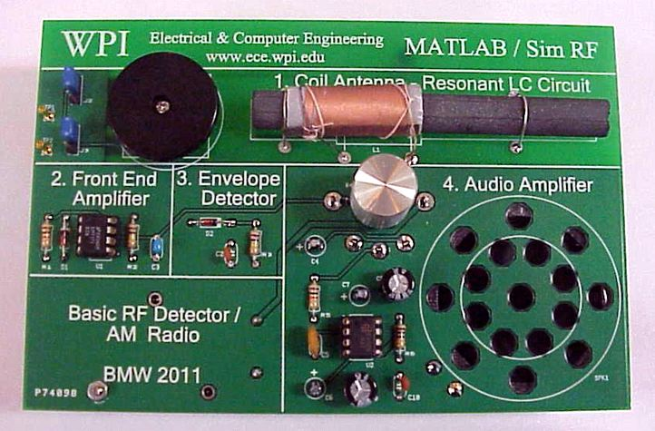
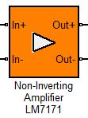
Amplifier model example in SimRF:
basic RF power detector/AM radio

